Slide 1

Linear Regression Model Deep Dive

Slide 2
Linear Regression
Regression
Linear Regression
Supervised Learning
Predicting Numerical Values (Price/ Height)
Classification

Slide 3
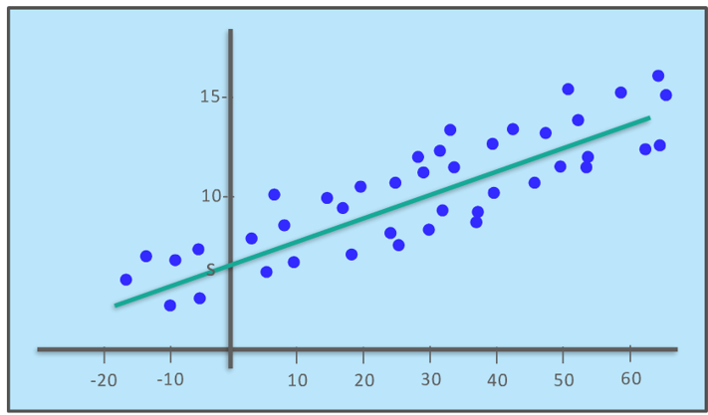
Supervised Learning : Linear Regression
What is Linear Regression?:
Linear Regression is the prediction of numeric value based on an input (often takes a continuous values).
Here we try to fit a mathematical function that describes a curve, such that the curve passes as close as possible to all data points
Linear Regression Equation:
The general form of a Linear regression equation is as below :
y = ax +b + E
where y is dependent variable , x is independent variable, b is y intercept , a is slope of the line and E is error variable
Dependent variable is the variable to be predicted or explained
Independent Variable is related to dependent variable in the equation.

Slide 4




Regression Applications
Predicting life expectancy based on features like Eating pattern, Medication, disease state etc.
Predicting weight base on features like sex, height , prior information about parents etc.
Predicting crop yield based on features like soil precipitation, Rain Fall, Fertilizer , Temperature etc.
Predicting house price hike based on features like House Size, Floor Size, Number of rooms etc.

Slide 5
Sample Use Cases for Linear Regression Model Predicting the future medical expenses of individuals for Insurance

Slide 6
Agenda
Challenge / Problem Statement (Sample)
Pre-Modelling Analysis
Univariate Analysis
Bivariate Analysis
Correlation Analysis
Regression Modelling
Simple Linear model
Anova
Residual Analysis
Diagnostics plot
Analytics Insights / Results (Sample)
Q&A

Slide 7
Challenge / Problem Statement (Sample)
The Insurance dataset consists of 1338 observations with 7 variables.
The challenge is to predict future medical expenses of individuals that help medical insurance to make decision on charging the premium.

Slide 8
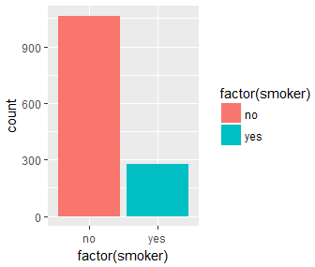
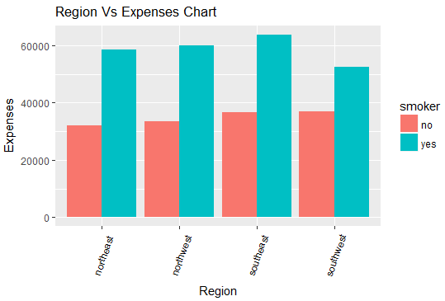
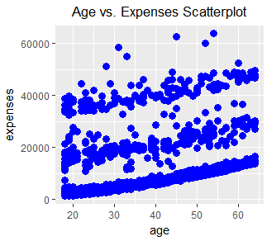
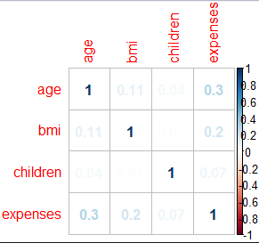
Pre Modelling – Insurance dataset - Data description
The insurance dataset contains 1338 observations (rows) and 7 features (columns).
The dataset contains 4 numerical features (age, bmi, children and expenses) and 3 nominal features (sex, smoker and region) that were converted into factors with numerical value designated for each level.
The challenge is to predict future medical expenses of individuals that help medical insurance to make decision on charging the premium.
Univariate Analysis -
Study of relationship for each single variables
Bivariate Analysis -
Study Relationship between 2 Variables and establish if the Relationship is Statistically Significant
Correlation Analysis
a statistical measure that indicates which two or more variables fluctuate together.

Slide 9
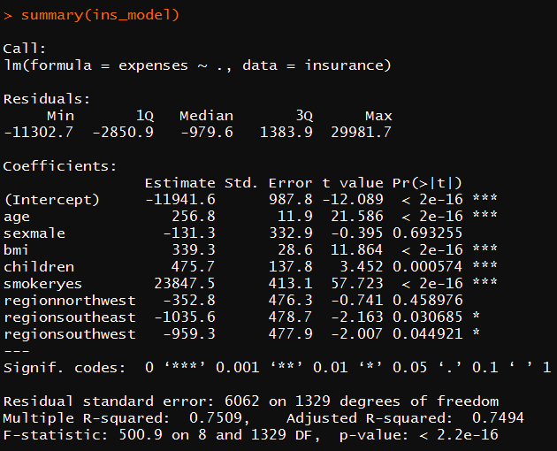
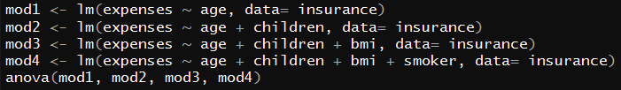
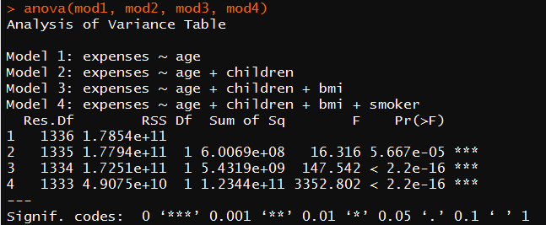
Linear Regression
Simple Linear Model
Analysis of Variance

Slide 10
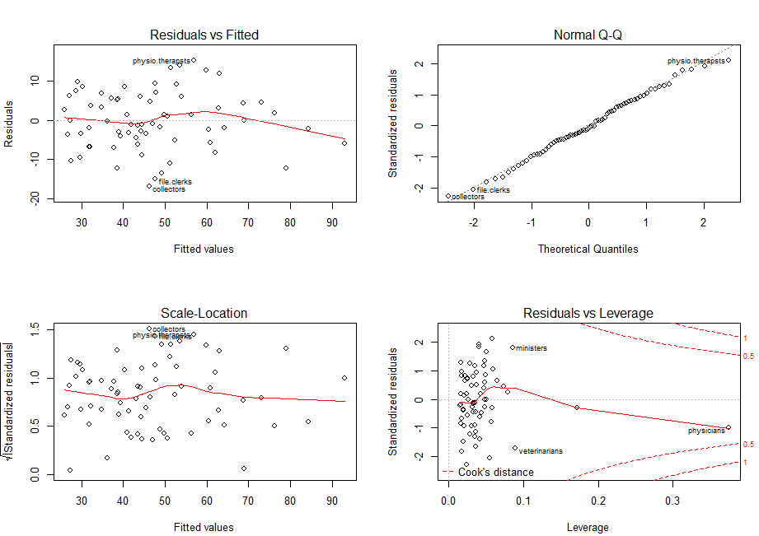
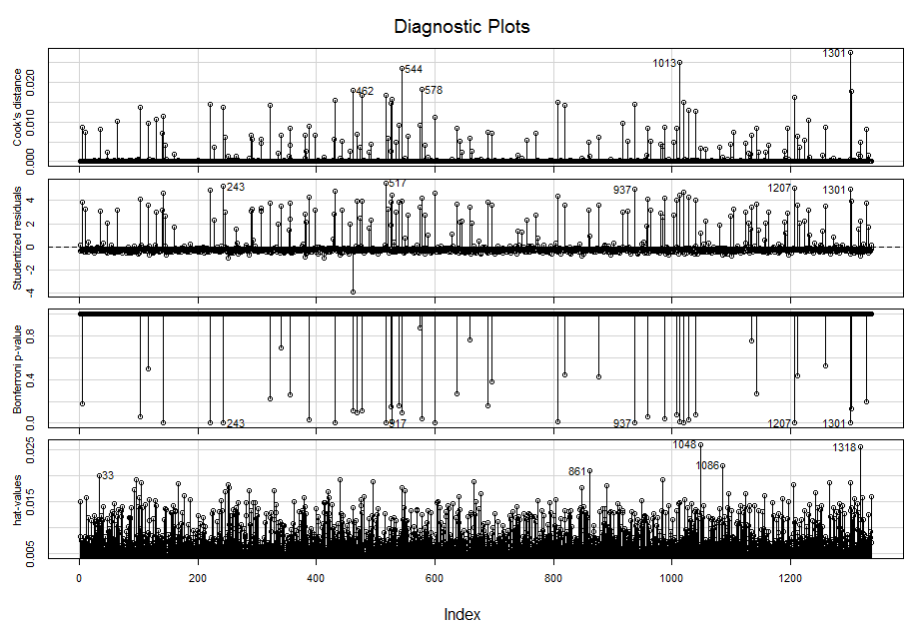
Linear Regression
Residual Analysis
Diagnostics Plot
The Top-Left Plot is the "Plot of Residuals against the Fitted Values"
Bottom-Left has the "Standardized Residuals in the Y-Axis"
If the "error variance increases with fitted values", that condition is called "Heteroskedacity". (This condition should be avoided to ensure that the model does not behave unpredictably, especially for new data)
Leverage is a measure of "how much each data point" "influences the regression". Cook's distance shows how much the "fitted values" would change if an Observation is removed. Points that are more than 4 times the mean are considered as "Influential or Extreme Points"

Slide 11
Analytics Insights / Results (Sample)
A multiple linear regression is originally modeled using several numerical and nominal features such as age, sex, number of children, bmi and regions.
The model performance can be evaluate by looking at the model statistics such as residuals range, estimated on coefficients on the regression, overall model and individual feature p-values, and R-square
In other words, medical expenses of individuals has a positive linear relationship with the predictors, age, sex, number of children, bmi, smoker and regions and help the insurance company to take decisions on charging the premium.

